Slide 1
Special Needs Trust Planning Basics and
ABLE ACCOUNTS
The Rooks Law Firm, LLC
Jessica Rooks

Slide 2
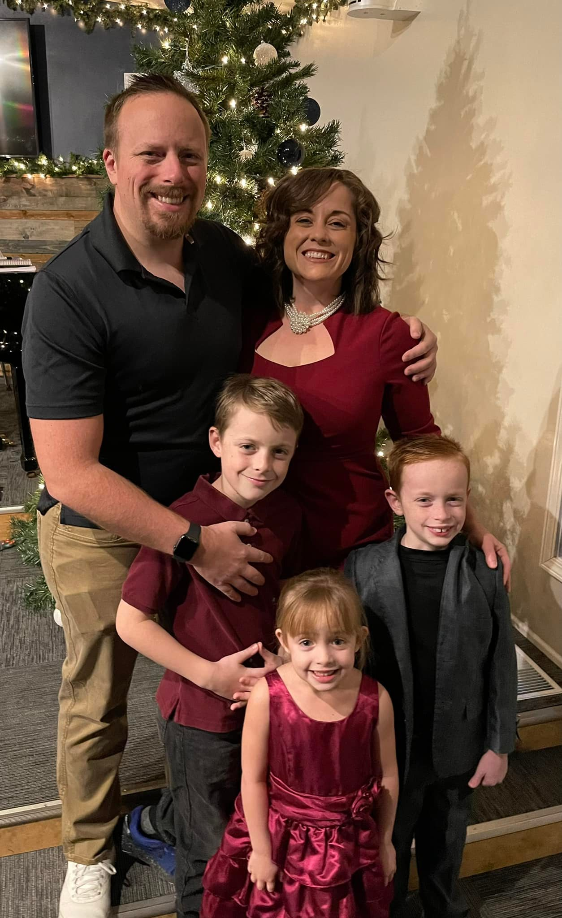
About the
Presenter
Jessica Rooks is the owner of the Rooks Law Firm.
Concentrates on Long-Term Care Planning, Estate Planning, Guardianships, and Special Needs Trust.

Slide 3

What is a Trust
A Trust is an agreement that determines how a person’s property will be distributed during that individual’s life and death.

Slide 4
Two Types of SNT
1st Party SNT
  Goal: protect a disabled person’s eligibility for current or future public benefits while also allowing access to additional funds to pay for expenses not covered by public benefits.
3rd Party SNT
  Goal: protect a disabled person’s eligibility for current or future public benefits while also allowing access to additional funds to pay for expenses not covered by public benefits.

Slide 5

Who is involved in a 1st and 3rd party SNT?
Settlor: who owns the property
1st Party: Disabled Person
3rd Party: Anyone else

Slide 6

Beneficiary: Person to receive what is in the trust

Slide 7
  Trustee: Take care of the property and money and is legally responsible for what is in the trust.

Slide 8
Benefits of a 3rd Party Trust
SNT may be created by a person who would like to help provide for another individual without hurting that person’s eligibility for public benefits.
If it is a revocable trust it can be changed.
Allows for funds to stay in the family after the death of the beneficiary.
If it is funded now and irrevocable, can be sent off for review.

Slide 9
Benefits of a 1st Party Trust
Most 1st Party SNTs are established to protect the proceeds of a personal injury settlement or inheritance.

Slide 10
Drawbacks of a 1st party Trust
There is an age requirement that the disabled individual must be under.
The individual must be disabled under the definition set forth in the Social Security Act.
Upon the death of the trust beneficiary, or upon earlier termination of the trust, the trustee must pay back the state for any governmental benefits expended on behalf of the disabled person during his or her lifetime.

Slide 11
Two Types of 1st Part SNT
Pooled Trust
  May have issues with spending money on shelter or food
  May have issues with owning land or a house
  Ideal for smaller amounts of funds
  Charitable donation provision
Privately Managed
  Can own land and a house
  At trustees discretion may decide to spend on food and shelter for decreased government benefit.
  Ideal for larger funds

Slide 12
Where can funds for an SNT go?
The following list is merely examples of possible distributions, but is by no means exhaustive:
Accounting services
Acupuncture
Appliances
Assistive technologies
Care manager
Cleaning services
Clothing and shoes
Computer (including hardware, software, repairs, and internet)
Dental work (not covered by Medicaid)
Dry cleaning and clothing repair
Elective surgery
Extra-curricular activities
Furniture and other home items (towels, bedding, etc..)
Insurance (car, home, etc..)
Legal fees
Transportation costs (car, bus pass etc.)
Telephone service (land line, cell phone, etc.)
Utility bills (cable, gas, heat, air conditioning, etc..)
Vacations

Slide 13
What are the steps?
1. Visit with a knowledgeable attorney to determine if your situation requires a SNT.
2. Create the SNT through attorney.
3. Have a trustee administer the trust.

Slide 14
ABLE ACCOUNTS
Please visit www.moable.com for the below information in more detail!

Slide 15
What are they?
A great way to have extra funds available for a disabled indiviudals needs when on public need based programs.
Investment account for individuals with disabilities.

Slide 16
Disability Requirements
Must be disabled prior to age 26 AND
  Eligible to receive SSI or SSDI
  Condition listed on SSAs list of compassionate allowances conditions OR
  Self-certification

Slide 17
Able Accounts
You can only have one ABLE account
Requires at least $25.00 to open an account. Future deposits can be as little as $1.00.
$39.00 annual fee to maintain account; and an asset-based fee between 0.19% and 0.33%
Maximum yearly contribution is $16,000 from any person or source.
  If employed may be able to contribute additional amount.

Slide 18
Balance over $100,000 counts as a resource for SSI
STABLE visa card is available to access the money. The money is loaded onto the card.
You can have a STABLE account and a special needs trust.
Employers can direct deposit into the account.

Slide 19
Who can Help Establish the Able Account
Beneficiary
Agent under POA
Conservator or Guardian
Spouse
Parent
Sibling
Grandparent
Representative Payee
In the order listed

Slide 20
An expense is considered a "Qualified Disability Expense" if:
(1) You incurred the expense at a time when you were an Eligible Individual;
(2) The expense relates to your disability; and
(3) The expense helps you to maintain or improve your health, independence, or quality of life.

Slide 21
Examples of Qualified Disability Expenses
Note: This list contains many examples, but it is not exhaustive. There are many other types of Qualified Expenses that are not listed here.

Slide 22
Basic Living Expenses
• Food
• Clothing
• Personal care items
Housing
• Purchase of a primary residence
• Expenses for a primary residence
• Home improvement, modi􀀁cations, maintenance, and repairs
• Rent
• Mortgage payments
• Real property taxes
• Utility charges
NOTE: SSI benefits can be affected if you use ABLE funds for any housing expenses.

Slide 23
Transportation
• Expenses for transportation
• Use of mass transit
• Purchase or modification of vehicles
• Moving expenses
Education
• Tuition for preschool through post-secondary education
• Books
• Supplies and educational materials
Assistive Technology and Personal Support
• Expenses for assistive technology and personal support
• Remote monitoring equipment & services
• Communication devices
• Screen reader software

Slide 24
Employment Training and Support
• Moving expenses
• Expenses related to obtaining and maintaining employment
• Job-related training
Health, Prevention and Wellness
• Expenses for health and wellness
• Premiums for health insurance
• Mental health, medical, vision, and dental expenses
• Habilitation and rehabilitation services
• Durable medical equipment

Slide 25
• Therapy
• Respite care
• Long-term services and supports
• Nutritional management
• Communication services and devices
• Adaptive equipment
• Personal assistance

Slide 26
Miscellaneous Expenses
• Financial management and administrative services
• Legal fees
• Expenses for oversight
• Monitoring
• Funeral and burial expenses.

Slide 27
Non-Qualified Expenditures
If you spend your STABLE Account funds on a non-qualified expense, you will have to pay regular income taxes, plus a 10% additional tax, on the earnings portion of those non-qualified funds.
Additionally, the non-Qualified funds you withdraw could be counted against you for purposes of determining your eligibility for means-tested public benefits programs, like Medicaid or SSI.

Slide 28
Drawbacks
Medicaid payback provision

Slide 29
Customer Service Information
Call 1-800-439-1653
www.moable.com
Email: team@stableaccount.com

