Slide 1
LeAnn Dent, MEd, PLPC
leann@renewcounseling.us

Slide 2
Coping with Grief:
Tools for moving forward

Slide 3
Goals:
Review symptoms of grief
Identify strategies for coping with grief
Practice using tools to express grief
Identify appropriate support

Slide 4
Symptoms of Grief
Emotional Symptoms:
Shock and disbelief
Sadness
Guilt
Fear
Anger
Insecurity
Physical symptoms:
Fatigue
Nausea
Insomnia
Weight loss or weight gain
Aches and pains
Lowered immunity

Slide 5
Feel your feelings
Acknowledge the pain
Identify the emotion
Need:
Tool:

Slide 8
Express your feelings
Create, Cry, Dance, Draw, Listen to Music, Pray, Sing, Talk, Volunteer, Write
Need:
Tool:

Slide 9
How to Express Feelings:

Slide 10
Receive care and don’t isolate
Lean on friends and family
Join a support group
Talk to a counselor
Need:
Tool:

Slide 11
Grief Support Group
Six Weeks
Friday, April 22, 11:00am

Slide 12
Remember your loved one
Look at photos,
Tell living stories,
Celebrate important dates
Need:
Tool:

Slide 14
Develop future hope
Meaning-making,
Grief as growth, Pray
Need:
Tool:

Slide 15
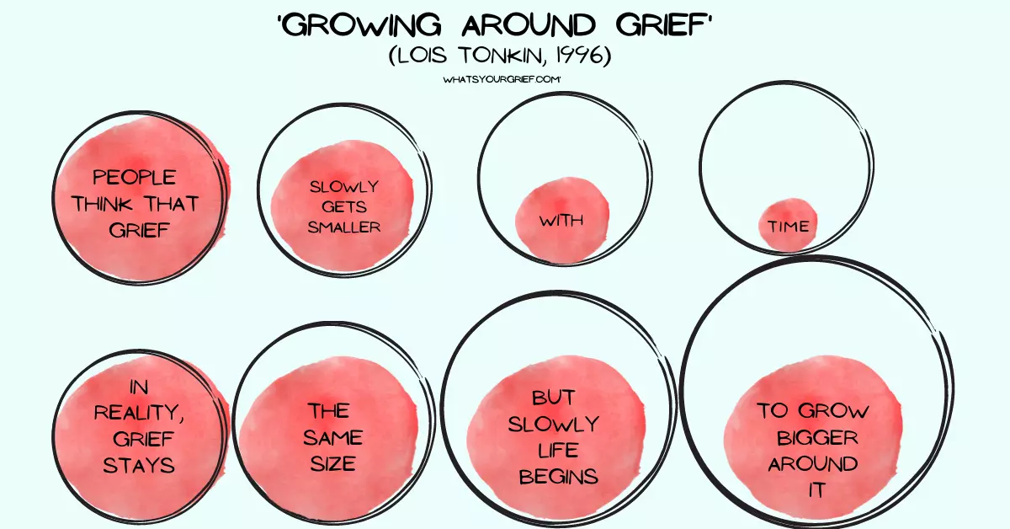

Slide 17
Plan ahead for triggers
Self-care & Self-compassion
Need:
Tool:

Slide 19
Grief Support Group
Six Weeks
Friday, April 22, 11:00am

Slide 20
LeAnn Dent, MEd, PLPC
leann@renewcounseling.us

