Slide 1
Guardianship and Conservatorship
Jessica Rooks

Slide 2
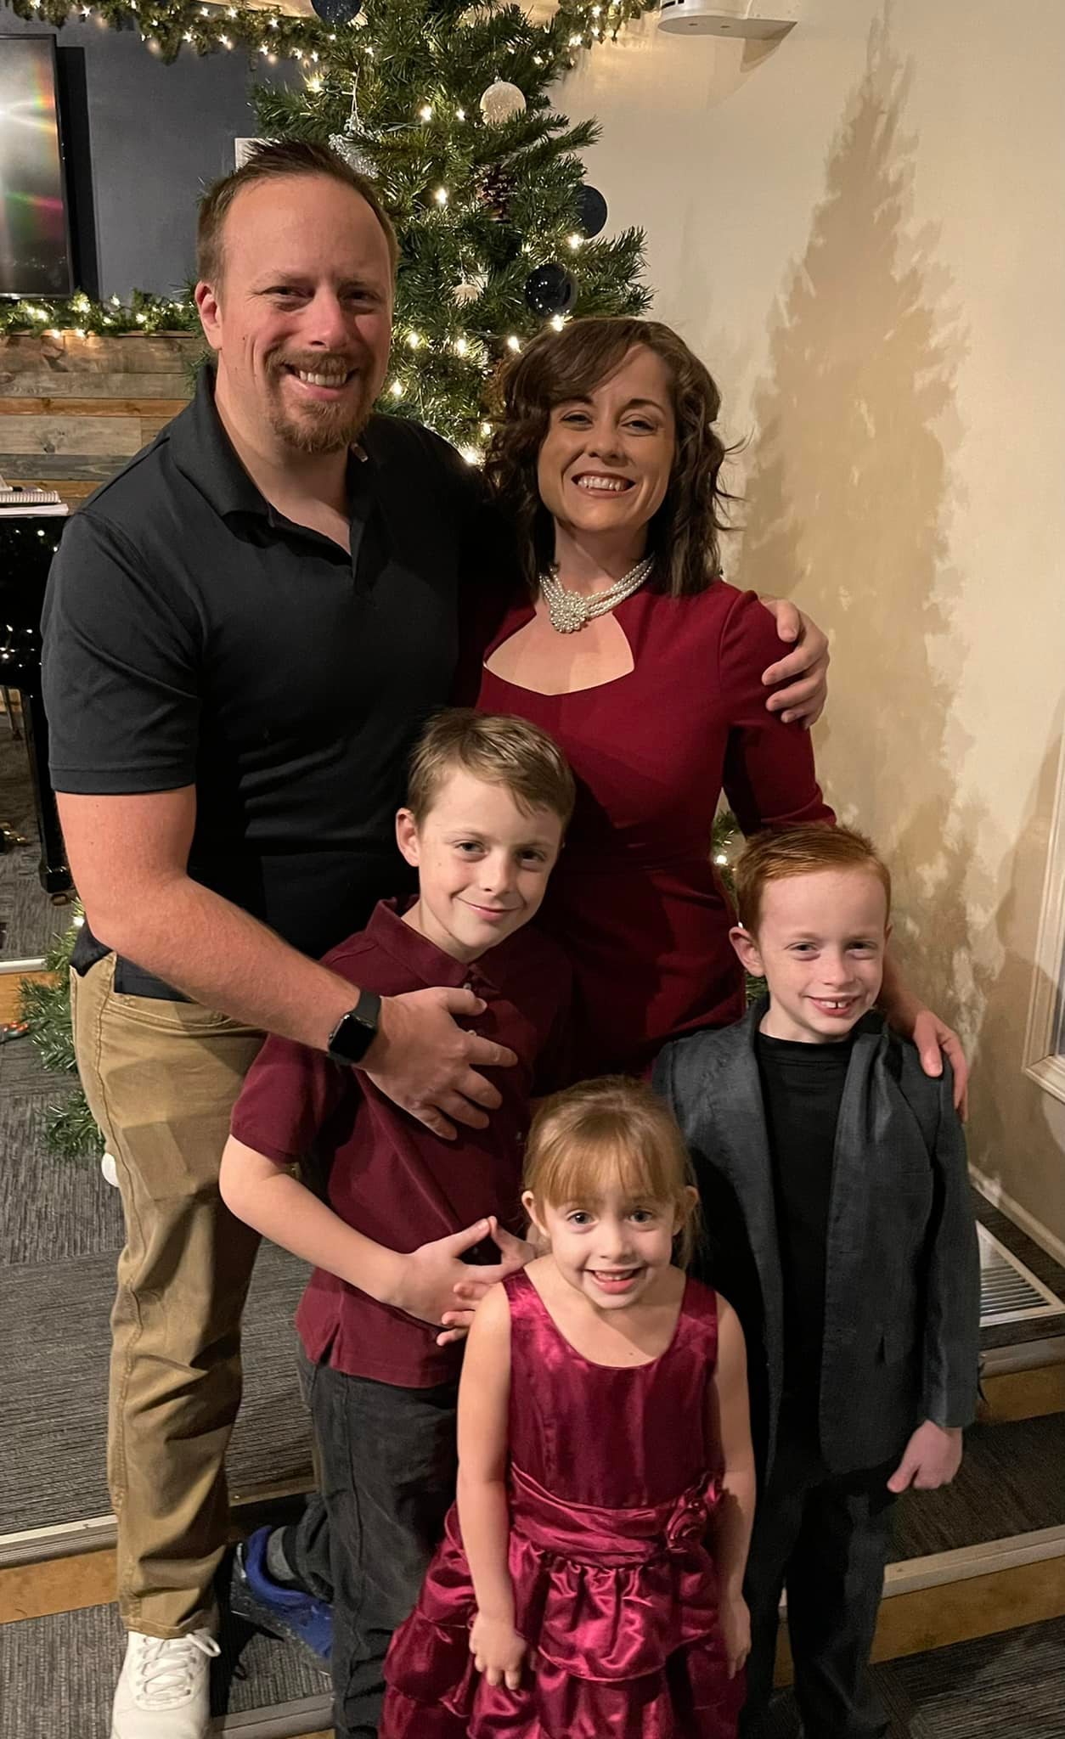
About the Presenter
Jessica Rooks is the owner of the Rooks Law Firm.
Concentrates on Long-Term Care Planning, Estate Planning, Guardianships, and Special Needs Trust.

Slide 3
Which Would You Have For Breakfast?

Slide 4
You have an hour of free time:

Slide 5
You get a Covid Check:

Slide 6
Capacity
An incapacitated person is unable to receive and evaluate information or communication decisions to such an extent that he lacks capacity to meet his essential requirements for food, clothing, shelter, safety, or other care such that serious physical injury, illness or disease is likely to occur because of his physical or mental condition.
A disabled person is unable by reason of any physical or mental condition to receive and evaluate information or to communicate decisions to such an extent that the person lacks ability to manage his [or her] financial resources.

Slide 7
Does capacity exist?

Slide 8
EMPLOYMENT
MONEY MANAGMENT
financial exploitation
HEALTH & NUTRITION
Medicine
Personal hygiene
Medical treatment
High risk behaviors

Slide 9
RELATIONSHIPS
Marriage
PERSONAL SAFETY
Abuse – physical/financial
COMMUNITY LIVING
PERSONAL DECISION-MAKING
Vote
Criminal activity
Understand legal documents
DETERMINING & DIRECTING SERVICES and SUPPORTS

Slide 10
Power of attorney versus Guardianship and Conservatorship

Slide 11
What is a guardian or conservatorship?
 | Conservatorship | Guardianship
Respondent | Protectee | Ward
Plaintiff (You) | Conservator | Guardian
Goal: | Manage Money | Care for the person

Slide 12
What rights are influenced?
Right to marry or divorce
Vote
Drive
Seek or retain employment
Agree to contracts
Consent to medical treatment
Sue and defend lawsuits
Apply for government benefits
Manage money or property
Where to live
Who to be friends with

Slide 13
Guardianship
Respondent is known is referred to as the “ward”.
The ward lacks the legal ability to make medical or psychiatric treatment decisions, to make placement decisions, to vote, to drive an automobile.
If the court says there is only a partially legal incapacity/disability, the extent to which the respondent’s rights are limited will be specified by court order.
The court is now responsible for the ward’s body and they have entrusted a guardian to make sure this person is properly cared for.

Slide 14
Conservatorship
Respondent is referred to as the “protectee”
Protectee lacks the legal ability to handle his or her own financial resources.
If the court says there is only a partially legal incapacity/disability, the extent to which the respondent’s rights are limited will be specified by court order.
The court is now responsible for the protectee’s money and they have entrusted a conservator to make sure this person’s money is properly cared for.

Slide 15
Guardian and Conservator’s Job
It is the guardian’s and conservator’s duty to prevent the ward or protectee from exercising rights limited or taken away by the court.
The court order will tell you exactly how much authority you have
Must notify the court in writing if the ward/protectee dies, you or the ward or protectee move from one address to another
You are under a duty, at all times, to act in the best interests of your ward-protectee and to avoid conflicts of interest which impair your ability so to act.
If you fail to perform any of your duties as guardian or conservator, you are liable to be removed from office and may be held personally liable for any loss or damage sustained by the ward or protectee by reason of your failure.

Slide 16
Guardian’s Job
Duty to care for the person of the ward
Provide for the ward’s care, treatment, habilitation, education, support and maintenance;
Powers and Duties of the Guardian:
Finding the best and least restrictive living environment available
Assuring that the ward receives medical care and other services that are needed;
promoting and protecting the care, comfort, safety, health, and welfare of the ward; and
providing required consents on behalf of the ward.
You will be required to file a personal status report annually concerning the care, welfare, and placement of your ward.

Slide 17
Conservator’s Job
Take possession of protectee’s property
The property, income and bank accounts must be kept separate from your own funds.
You must invest the protectee’s funds prudently and according to law.
You may only spend the protectee’s funds for purposes authorized by law.
You must account for every dollar you spend and you must ask permission to spend, before you do it.
You will be required to file an annual accounting (called a settlement) showing in detail all money that has been received and spent during the year. EVERY DOLLAR MUST BE EXPLAINED AND AUTHORIZED.
Write checks; keep receipts.
You may not sell, trade, lease, mortgage, transfer or discard your protectee’s property without court approval, even though the protectee is your child or other relative.

Slide 18
I have to have court permission for:
Buying gifts for other people, Generally this WILL NOT be authorized.
Buying a car
Trading a car
Selling personal property on swap shop
Buying a home, selling a home
If you are spending money and have not asked permission for it, consider it not allowed- conservative approach

Slide 19
I have to:
Manage my protectee’s money
Pay bills on time- but you have to have permission so it takes planning!

Slide 20
Continuing role of the attorney
Can ask court for spending money (Petition)
Can file annual settlement
A conservator cannot represent the protectee in court without an attorney

Slide 21
How to Request a Guardian/Conservatorship
Guardian ad Litem (GAL)- protectee/ward’s attorney; GAL fees
Court cost
Court bond
Attorney fees for petitioner

Slide 22
Interrogatories from the doctor before hand
Protectee Must be 18 years or older
Petition
List Respondent’s family
List Respondent’s property
List Witnesses- Doctor (interrogatories), Plaintiff, and others as needed
Statement that you consent to appointment and no banned criminal history
That ward/protectee wants you as a guardian/conservator

Slide 23
Summary
 | Conservatorship | Guardianship
Respondent | Protectee | Ward
Plaintiff (You) | Conservator | Guardian
Goal: | Manage Money | Care for the person
On-going duties | Petition the court when spending resources; | Annual status report about the care, welfare, and placement

Slide 24
Feel free to reach out! Jessica Rooks (660) 627-3369 or
email JessicaRooks@RooksLawFirm.com

