Slide 1
Estate Planning Basics: Wills and Avoiding Probate
Begins
at
5:30 p.m.

Slide 2

Estate Planning Basics: Wills and how to avoid probate
The Rooks Law Firm, LLC
Jessica Rooks

Slide 3
About the Presenter
Jessica Rooks is the owner of the Rooks Law Firm
Concentrates on Long-Term Care Planning, Nursing home planning, Estate Planning, Guardianships, and Special Needs Trust.

Slide 4
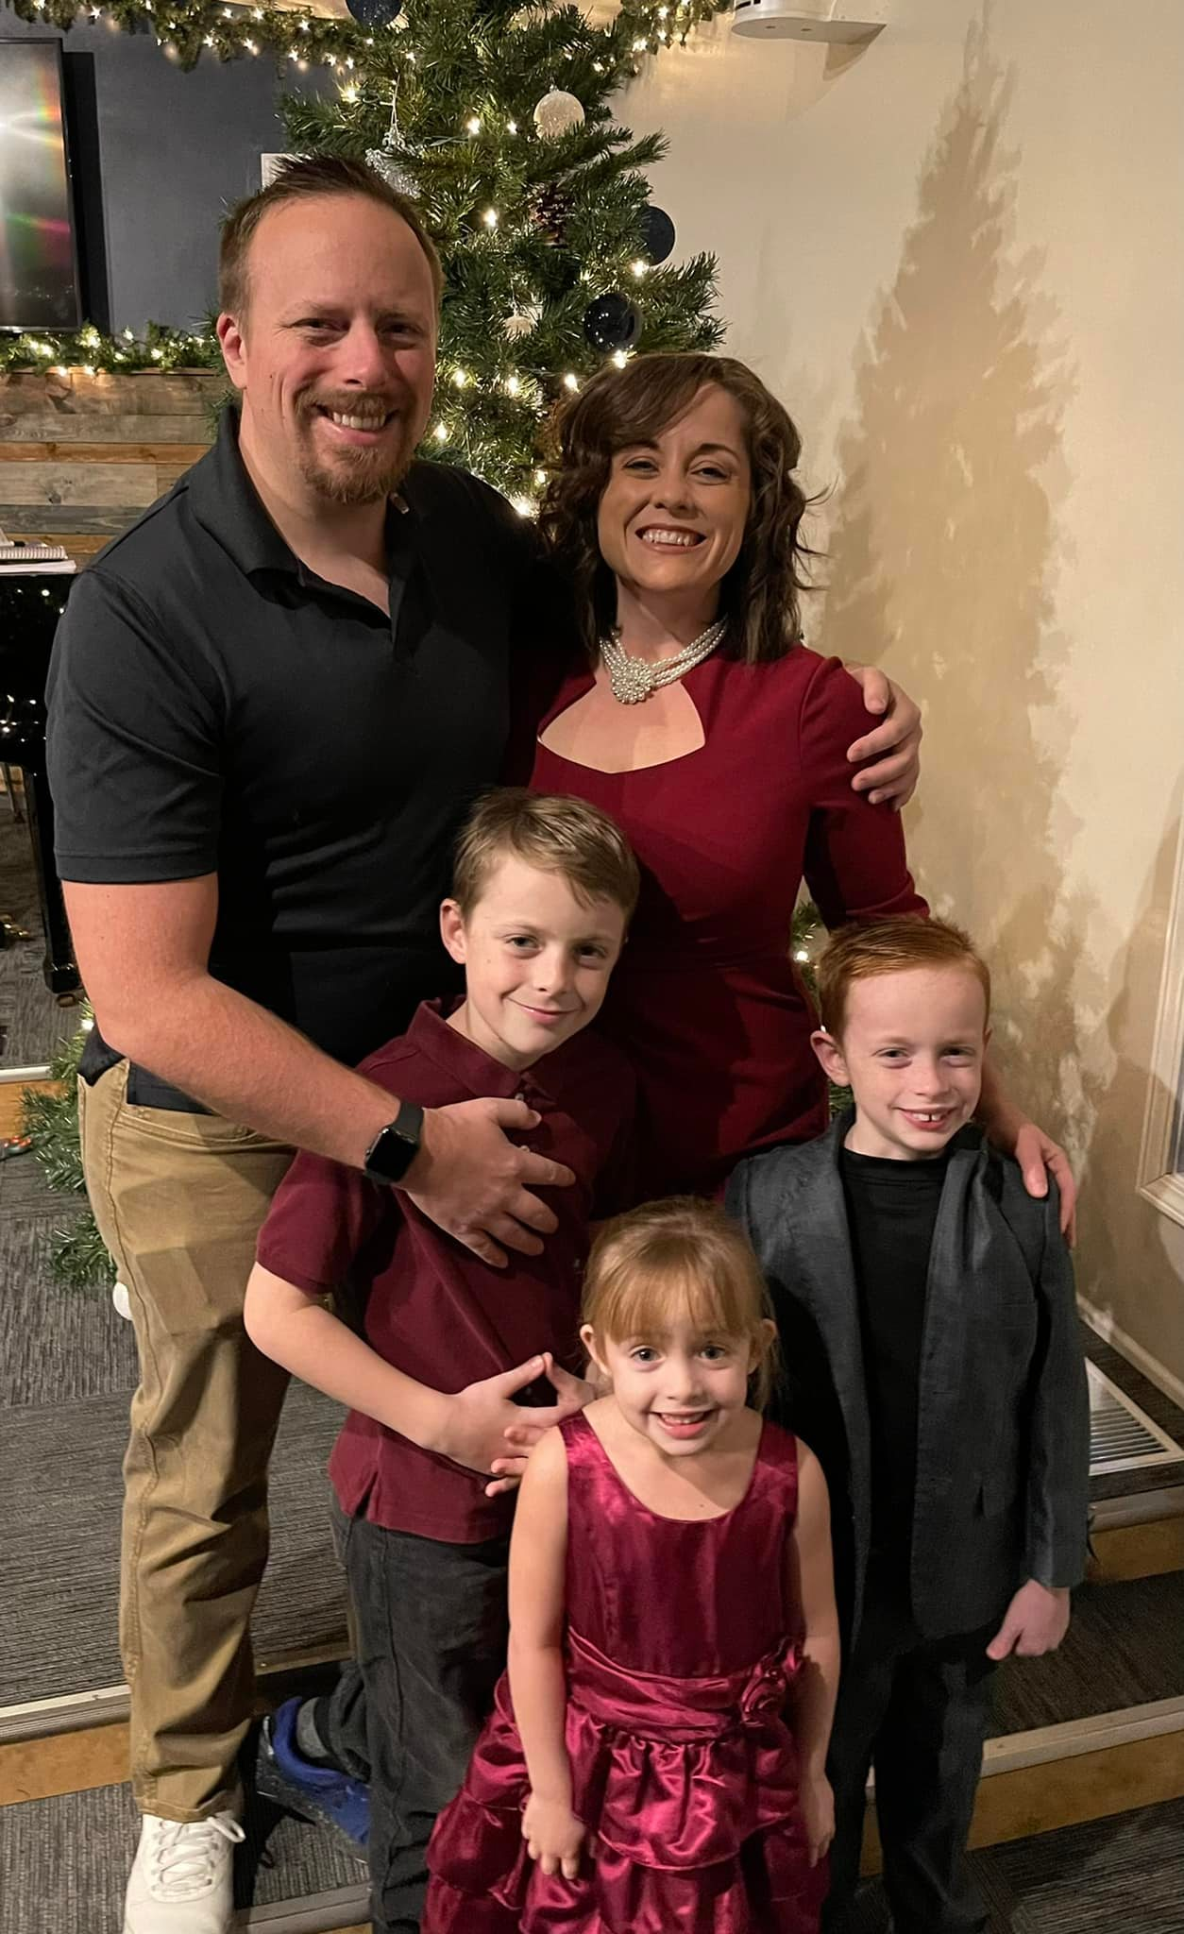
Jessica Rooks of
The Rooks Law Firm

Slide 5
What is Probate?
Probate is the way to give the probate property of the deceased to the living.
Probate property is property that you don’t know where it goes.

Slide 6
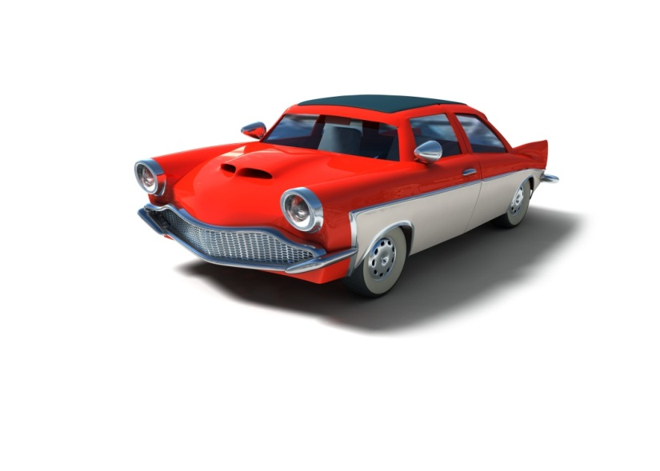



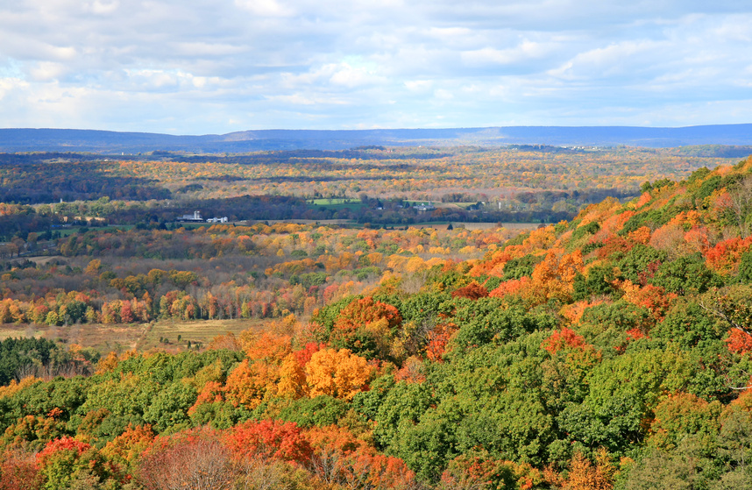

Slide 7
Problems of Probate
Situation:
  Wife has $100,000.00 Bank account with only her name on it as owner and no beneficiaries.
  At time of wife’s death, she was married to her husband, had been for 40 years. Her and her husband had 3 kids.
  Who gets the money?

Slide 8
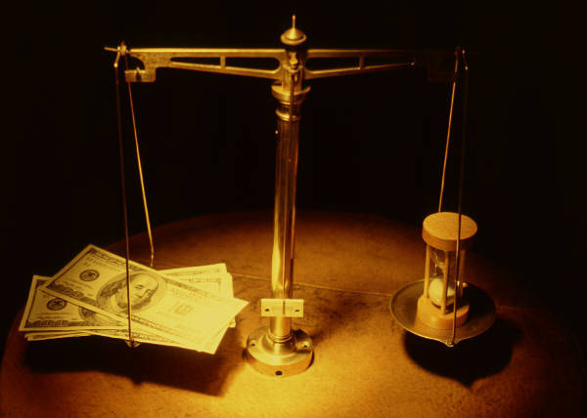

Problems of Probate

Slide 9
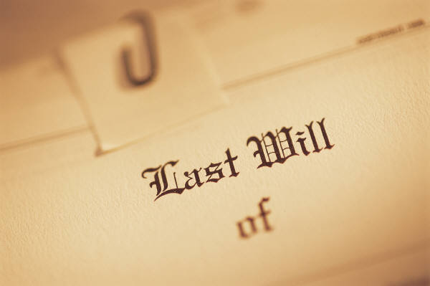
What is a Will?
A legal paper that states who receives your PROBATE property when you die.

Slide 10



Benefits of a Will

Slide 11
Additional
Benefits
of a
Will
Can designate guardian and conservator for children
Good and complete will can help avoid conservatorship for minor or disabled individuals receiving an inheritance

Slide 12
Drawbacks of a Will
Doesn’t avoid probate!!!!

Slide 13
Who can make a will?
An adult over 18
Sound mind

Slide 14
How can probate be avoided?
Giving away property
Using a trust
Setting up joint accounts with rights of survivorship
Naming individuals as beneficiaries of life insurance or retirement accounts
Creating pay on death or transfer on death designations

Slide 15
Non-Probate Concerns
Everyone has to get along
Transfers to minors may create a conservatorship
Transfers to disabled individuals can hurt their benefits
May not address long-term care concerns- recovery from the State if Medicaid with nursing home
No protection: Divorce, creditors, liabilities, drug use

Slide 16
Trust

Slide 17
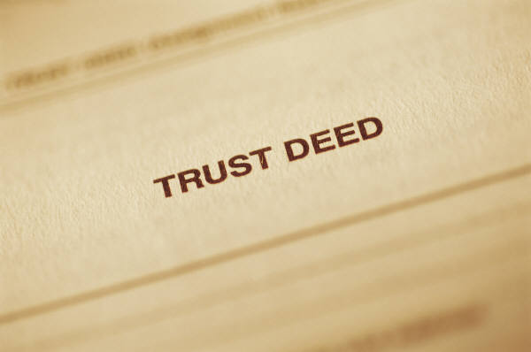
What is a Trust
A Trust is an agreement that determines how a person’s property will be distributed during that individual’s life and death.

Slide 18
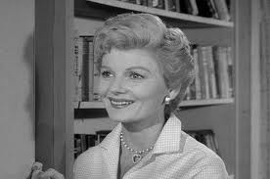
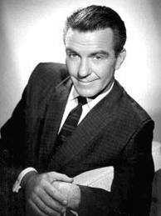
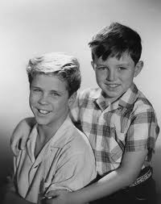
Who is involved?
Settlor: creator of the trust; own the property
Beneficiary: Person to receive what is in the trust

Slide 19
  Trustee: Manages the trust and is legally responsible for what is in the trust.

Slide 20
Types of Trust
Revocable
Irrevocable

Slide 21
Drawbacks of a Trust
Can be costly to make.
Difficult to remember to properly fund it
Cost to administer after death

Slide 22
Events that may need a trust

Slide 23
Situation | Situation | Situation | Situation
My children have bad credit or are bad with money | My children may squabble after I am gone. | I am in a high estate tax bracket | I want my children to inherit but still allow my second spouse to live in the property and use my assets while he/she is alive
My children may get a divorce | My assets are complex and will need help being managed if I become disabled or pass away | I do not want my estate to go into probate | I want specific items to go to specific people
My child has a disability | I want my children then my grandchildren to have my land | I may need Long term Care and can’t afford it
My child is a minor | My Child has drug issues

