Slide 1
LeAnn Dent, MEd, PLPC
leann@renewcounseling.us

Slide 2
Introduction to Grief:
Myths & Facts

Slide 3
Goals:
Discuss myths and facts about grief
Discuss the grieving process
Identify types of grief and associated symptoms

Slide 4
Myth #1
Fact #1
Loss – the event (concrete or ambiguous)
Grief – the emotions in response to a loss
Mourning – an expression of those emotions
Grief, loss, and mourning are the same thing.

Slide 5
Myth #2
Fact #2
Everyone grieves in stages, and it should last about one year.
Everyone grieves differently, and grief doesn’t follow the rules of a specific time limit or pattern of stages.

Slide 6
Myth #3
Fact #3
Ignoring your pain will help it go away.
Pain is a natural part of life, but avoiding or ignoring it is only a temporary solution.

Slide 7
Myth #4
Fact #4
Moving on means forgetting about your loss.
Moving on means accepting loss and keeping meaningful memories.

Slide 8
Myth #5
Fact #5
Grief changes but does not follow a timeline.
Grief gets better over time and has an endpoint.

Slide 9
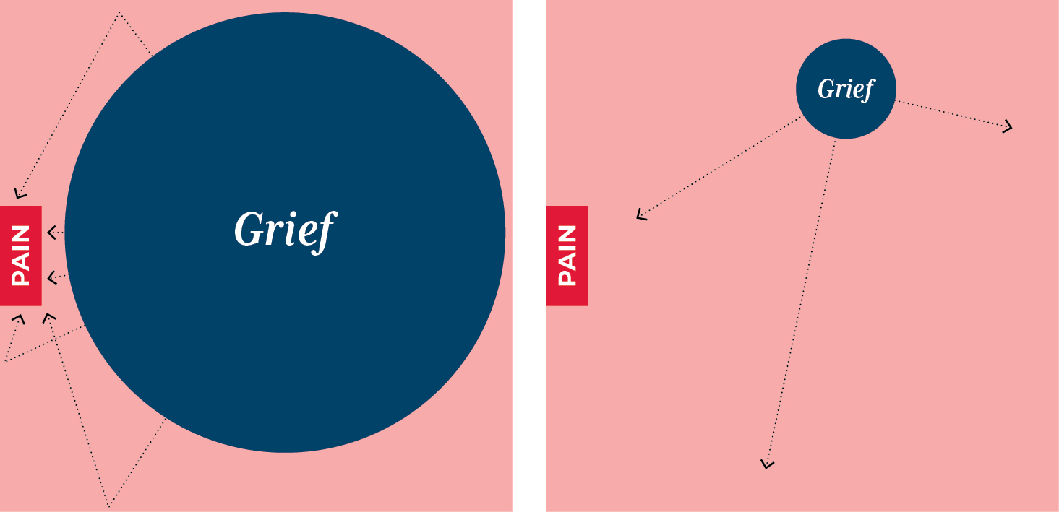

Slide 11
The Grieving Process
While grieving a loss is an inevitable part of life, there are ways to help cope with the pain, come to terms with your grief, and eventually find a meaningful way forward with your life.
Acknowledge your pain.
Accept that grief can trigger many different and unexpected emotions.
Understand that your grieving process will be unique to you.
Seek out face-to-face support from people who care about you.
Support yourself emotionally by taking care of yourself physically.
Recognize the difference between grief and depression.

Slide 12
From verywellmind.com

Slide 13
Symptoms of Grief
Emotional Symptoms:
Shock and disbelief
Sadness
Guilt
Fear
Anger
Insecurity
Physical symptoms:
Fatigue
Nausea
Insomnia
Weight loss or weight gain
Aches and pains
Lowered immunity

Slide 14
Types of Grief
Anticipatory Grief - before loss has occurred
Disenfranchised Grief - when grief is not validated
Complicated Grief - when grief remains unresolved and impairs functioning

Slide 15
Moving Forward
Learn ways to cope by living with grief rather than getting over it.
Grief Workshop #2: Coping with Grief and Loss, 4/8 at 11am
Find appropriate support.
Six-week Grief Counseling Group, 4/22 at 11am

